Slide 1
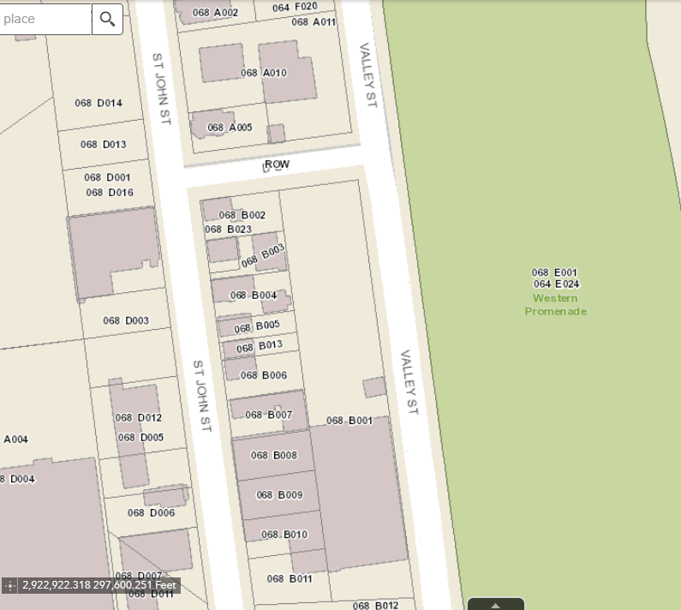
195 St. John
Alan Auto Volvo Service
PROSSER ALAN & BETH 195 ST JOHN ST PORTLAND ME 04102
776-1316
volvo@maine.rr.com
http://www.alanauto.com/
189 St. John
Single-family residential
MOLDAVER ROBERT E & JEANNE M HANDY
189 ST JOHN ST PORTLAND ME 04102
773-2966
181 St. John
Single-family
Steve Fowler
MECAP LLC PO BOX 4787 PORTLAND ME 04112
831-0727
151 St. John/120-160 Valley
The Granite Group
GPP PROPERTIES 1995-1 LLC 6 STORRS ST CONCORD NH 03302
321-6210
https://thegranitegroup.com/

