Slide 1
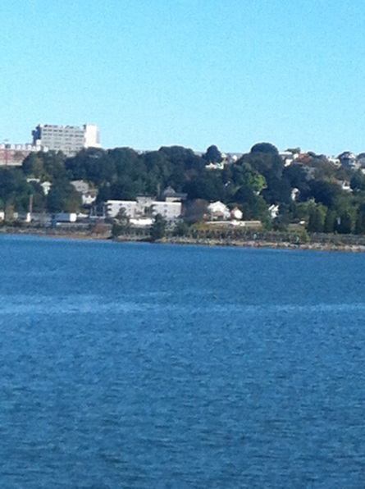
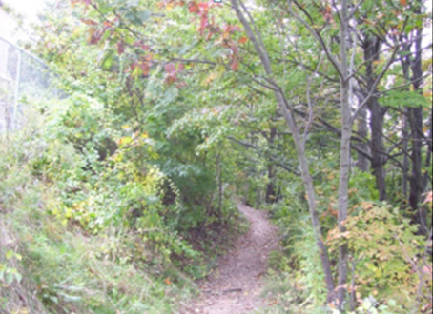
Save Munjoy Hill’s Last Open Green Space – Oppose 79 Walnut Street Proposal
Presented by Concerned Portland Citizens

Slide 2
Why Stop the 79 Walnut Street Proposal?
Current utilization of Munjoy Hill’s last open green space with current Jack’s Path.
At least 2 Portland City Ordinances that will not be met.
There is a HUGE environmental impact.
Conclusion

Slide 3
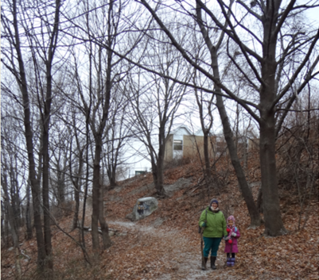
1. Current Utilization of Open Green Space With Current Jack’s Path
A) For a mother walking her child to the North Street School by taking a short cut through Jack’s Path.

Slide 4
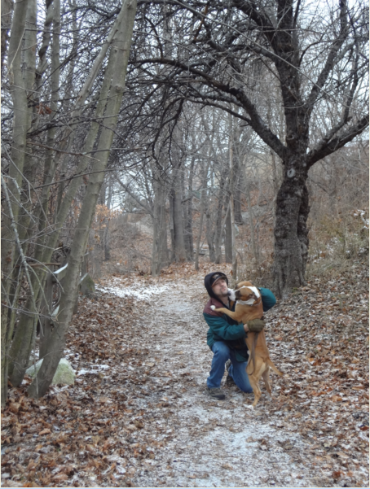
1. Current Utilization of Open Green Space With Current Jack’s Path (cont’d)
B) A long term resident of the Hill who walks his dog on the path and played in this open green space as a child.

Slide 5
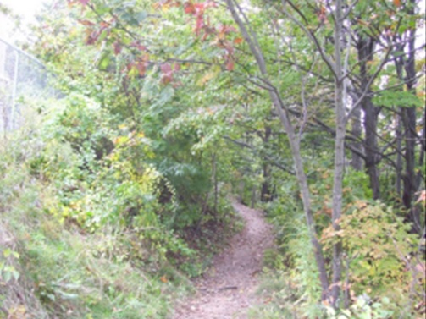
1. Current Utilization of Open Green Space With Current Jack’s Path (cont’d)
C) A respite for Portland citizens to get away from the heat of summer and the city noise.

Slide 6
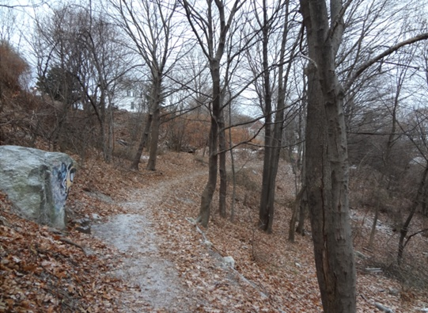
1. Current Utilization of Open Green Space With Current Jack’s Path (cont’d)
D) A quiet forested area for Portland residents who have limited access or time to visit forested areas outside Portland

Slide 7
2. City Ordinances that will not be met
A) Scenic Beauty, Natural, Historic, Habitat and other Resources (Section 14-497 (a) 8) The site is heavily wooded and visible from long views across Back Cove and from the peninsula. It is valued as a local natural area along the existing Jack Path.
In the developer’s vision, buildings will become the new view of the hill, forever changing the scenic beauty of Portland. City planners must consider subdivision ordinance 14:497 (8) “scenic beauty” when deciding on this project. Trees posses scenic and natural beauty, the elms are rare, wild and irreplaceable and have historical value in the Forest City.

Slide 8
2. City Ordinances that will not be met (cont’d) a) Scenic Beauty
BEFORE:

Slide 9
2. City Ordinances that will not be met (cont’d) a) Scenic Beauty
AFTER:

Slide 10
2. City Ordinances that will not be met (cont’d) a) Scenic Beauty
BEFORE:

Slide 11
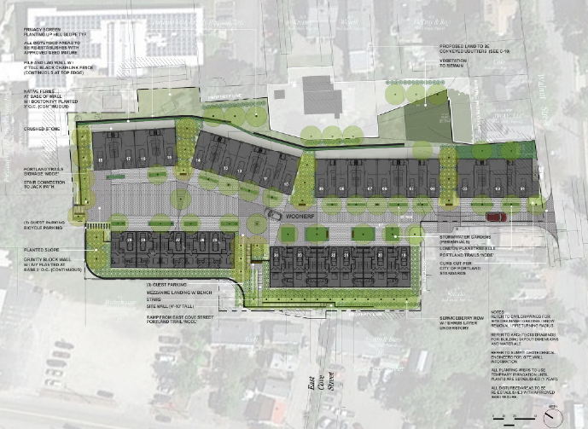
2. City Ordinances that will not be met (cont’d) a) Scenic Beauty
AFTER:

Slide 12
2. City Ordinances that will not be met (cont’d) a) Scenic Beauty
BEFORE:

Slide 13
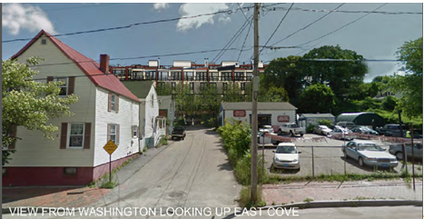
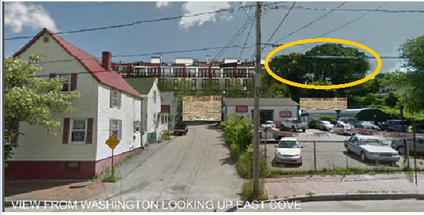
2. City Ordinances that will not be met (cont’d) a) Scenic Beauty
AFTER:
Note: Developer’s interpretation which has inaccurate tree height and no 18 ft retaining wall visual.
Opponents contend it will look more like right photo with no mature trees and 18 ft. retaining wall visual

Slide 14
2. City Ordinances that will not be met (cont’d) a) Scenic Beauty
BEFORE:

Slide 15
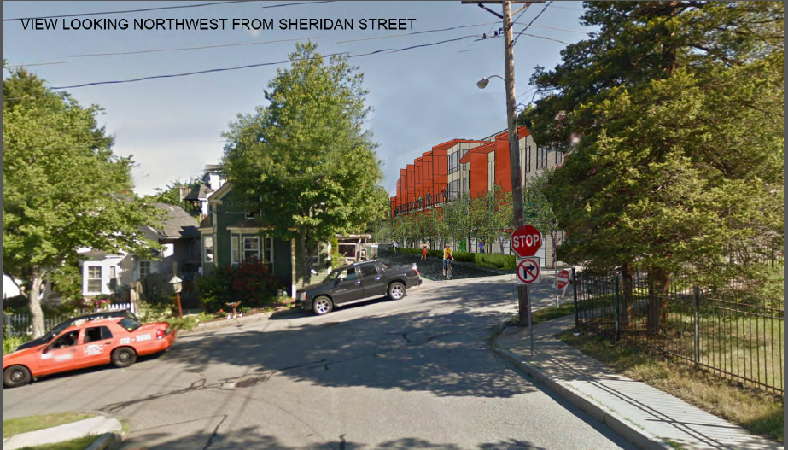
2. City Ordinances that will not be met (cont’d) a) Scenic Beauty
AFTER:

Slide 16
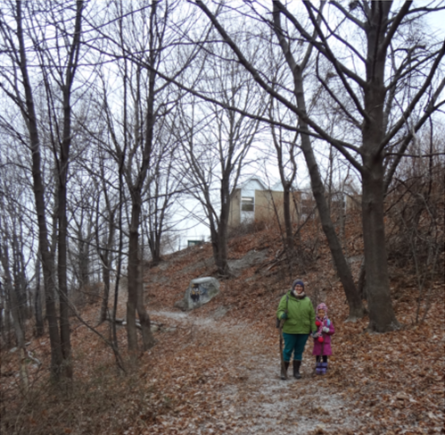
2. City Ordinances that will not be met (cont’d) a) Scenic Beauty
BEFORE:

Slide 17
2. City Ordinances that will not be met (cont’d) a) Scenic Beauty
AFTER:
Note: 1)Since this would be private property , what assurance that this “Woodnerf” area will remain open to the public for years to come? For example, Old Adams school property has a private park in which only after a year the residences are complaining that the children are too loud in the this private park. 2) The trees depicted in the above photo are not accurate portrayal of the trees that are proposed to be planted. The above trees depicted I estimate a height of > 30 ft and will only be that mature around 15 years.

Slide 18
2. City Ordinances that will not be met (cont’d)
B) Landscape Preservation (Section 14-525 (a) I,ii) The Board requested further information regarding the impact on the existing trees and the applicant commissioned a Tree Study and the Report. This study confirmed that there are 162 trees on the site, largely comprising Norway Maple. Of these, 39 were “mature” and over 10 inches dbh. Of these larger trees, 30 were Norway Maple, described as an “undesirable imported invasive species” that does not have forest and ecological value. Nine trees of other species were over 10”dbh, including some elm and oak (see plan at end of Tree Report) Per city ordinance, 30 % of native trees are to be saved but none are proposed for preservation
-There are only 100 elms identified left in the city of Portland and 9 (9%) are in this green space.

Slide 19
2. City Ordinances that will not be met (cont’d) b)Landscape Preservation
The current trees are mature and majority are over 50 ft. - Developer contends 75% are Norway Maple invasive tree species and it is justified to clear cut but does not save any of the native Elm, Oak, or Apple trees. - Opponents contend, this is no justification to clear cut since invasive plant species can be sustainably managed as they are on other Portland trails. These invasive species also provide the SAME scenic beauty, cooling, natural carbon dioxide absorption and prevent soil erosion just as the Native tree species.
Developer’s proposed plant listing will NEVER replace the current tree density, height, cooling, and carbon absorption capabilities as shown in next slide.

Slide 20
2. City Ordinances that will not be met (cont’d) b) Landscape Preservation
Native or Non-Native to Maine
Native: Max Height: 45’
Non-Native
Non-Native
Non-Native
Native
Native
Native
Native
Native
Native
Non-Native
Native
Non-Native
Non-Native
Non-Native
Non-Native
Non-Native
Non-Native
Non-Native
Conclusion: > 56% of the proposed Plant list is NON-NATIVE to Maine. Why is it okay to clear cut the current non-native tree species yet the developer proposed plant listing over 50% non-native plant species?

Slide 21
3. Huge Environmental Impact
A) Carbon Dioxide Consideration:
Did you know each mature tree absorbs 700 lbs of carbon dioxide annually? This is the reason why the current open green area is so cool and smells clean. The trees are doing their job.
Per Casco Bay Friends, CO2 is a direct factor in the acidification of the oceans which is currently one of the largest threats to Casco Bay.
By clear cutting all the 162 trees, this means that over 113, 400 lbs of carbon dioxide annually will NOT be absorbed any longer by this open green space.
This doesn’t include the additional cars being added to the hill for this proposal which will add conservatively an additional 138,720 lbs of carbon dioxide in the air.
This means an additional 252,120 lbs of carbon dioxide will be polluting Portland annually.
How will the developer replace this natural carbon dioxide adsorption mechanism for the city of Portland?

Slide 22
3. Huge Environmental Impact (cont’d)
B) High Potential for Erosion:
Currently, the proposed area has a 25% grade or greater.
Developer contends that due to the fact that 74% of the mature trees are non-native than that it justifies clear cutting the entire area. The proposed 18ft retaining walls do not fit into the aesthetics of the neighborhood and there is no guarantee that this will control erosion.
For example, in other cities such as Los Angeles, developers also had assured LA city planners the same thing when they were building on the sides of hills in LA but yet there are annual massive mudslides because of clear cutting for development and building on steep hill sides.
Opponents also contend that due to these predicted erosions and Casco Bay being done just downhill, this will further put greater stress on Casco Bay that has all ready been highlighted by the “Friends of Casco Bay”.

Slide 23
3. Huge Environmental Impact (cont’d)
C) Local Resident Had Seen Raptors in this Open Green Space:
A local highly respected resident had seen Maine endangered bird such the as peregrin falcon in this specific open green space.
Per the Department of Inland Wildlife and Fisheries website, Maine’s endangered bird list includes the peregrin falcon . Source: http://www.maine.gov/ifw/wildlife/endangered/listed_species_me.htm
Note: Further investigation by Maine IFW will be needed.

Slide 24
CONCLUSION
The citizens of Portland, Portland city government, and newcomers to Portland should not forget why we live here.
It is because of the: scenic beauty, neighborhood aesthetics, nature, open green spaces, historical preservation, conservation, affordable housing, walkable city, public transport opportunities, recycling, repurposing, and buying local.
Does the 79 Walnut Street project represent these aforementioned ideals? I contend no if this means clear cutting one of the last open green spaces within the city, creating more traffic congestion and carbon dioxide on Munjoy Hill so that 29 high end condos are developed in which only out of state people can afford to purchase.
KEEP PORTLAND REAL AND GREEN

Slide 25
Conclusion (cont’d)
I am including over 70 signatures from Portland residents that oppose this proposal gathered in the short span of time that we were aware of this proposal.
Finally, this open green space of SCENIC BEAUTY can NEVER be brought back to it’s current state if clear cut and excavated. Most buildings can always be replaced (except for the 1888 Gothic style Union Station demolished in 1961 on St. John’s St) but not natural open green forested spaces in cities. This is what makes Munjoy Hill special.
Will this open green space be saved for future generations? We hope so…..

